Slide 1
Computer Architecture
Vector Computers
Notes:
柯尔斯基．阿桑利克教授 ( Prof. Krste Asanovic )
Asanovic received his B.A. degree in Electrical and Information Sciences from Cambridge University in 1987, and his Ph.D. in Computer Science from U.C. Berkeley in 1998.
Krste Asanovic is an Associate Professor in the Computer Science and Artificial Intelligence Laboratory at MIT.
His main research interests are computer architecture and VLSI design and his current focus is on energy-efficient computing.
The SCALE group is developing technologies for future high-performance low-power computing systems.

Slide 2
contents
1. Why Vector Processors?
2. Basic Vector Architecture
3. How Vector Processors Work
4. Vector Length and Stride
5. Effectiveness of Compiler Vectorization
6. Enhancing Vector Performance
7. Performance of Vector Processors

Slide 3

Vector Processors
I’m certainly not inventing vector processors. There are three kinds that I know of existing today. They are represented by the Illiac-IV, the (CDC) Star processor, and the TI (ASC) processor. Those three were all pioneering processors. . . . One of the problems of being a pioneer is you always make mistakes and I never, never want to be a pioneer. It’s always best to come second when you can look at the mistakes the pioneers made.
Seymour Cray
Public lecture at Lawrence Livermore Laboratories
on the introduction of the Cray-1 (1976)
Notes:
西摩·克雷(Seymour Cray)被誉为是无可非议的“超级计算机之父”。
1957年，克雷和其它几位工程研究协会(ERA)的同事辞职后，创办了CDC。
1963年CDC 6600的推出，使得CDC公司成为了市场上真正的主导者，再到后来CDC 7600的推后，这台每秒运行1000万次的机器被公认是当时第一台真正意义上的超级计算机，克雷也成了举世闻名的超级计算机专家，CDC公司从此开始独霸整个超级计算机市场。
1972年，克雷自立门户，创立了克雷研究公司，公司的宗旨是只生产超级计算机。此后的十余年中，克雷先后创造了CRAY-1，CRAY-2等机型，他亲手设计了Cray机型的全部硬件与操作系统，其中的作业系统更是他用机器码编写完成。
1964年 · CDC 6600, 3 MFLOPS,
1969年 · CDC 7600, 36 MFLOPS,
1974年 · CDC STAR-100, 100 MFLOPS,

Slide 4
Supercomputers
Definition of a supercomputer:
Fastest machine in world at given task
A device to turn a compute-bound problem into an I/O bound problem
Any machine costing $30M+
Any machine designed by Seymour Cray
CDC6600 (Cray, 1964) regarded as first supercomputer
Notes:
1963年CDC 6600的推出，使得CDC公司成为了市场上真正的主导者，再到后来CDC 7600的推后，这台每秒运行1000万次的机器被公认是当时第一台真正意义上的超级计算机，克雷也成了举世闻名的超级计算机专家，CDC公司从此开始独霸整个超级计算机市场。

Slide 5
Supercomputer Applications
Typical application areas
  Military research (nuclear weapons, cryptography)
  Scientific research
  Weather forecasting
  Oil exploration
  Industrial design (car crash simulation)
All involve huge computations on large data sets
In 70s-80s, Supercomputer ≡ Vector Machine
Notes:
但好景不长，到了20世纪80年代后期 ，PC的发展如日中天，大型机和超级计算机都受到了较大的冲击，最终CRAY-3在商业市场上惨淡收场。此时的克雷再一次与公司的意见出现分歧，1989年他退出了自己一手创办的克雷研究公司，另行成立了克雷计算机公司，全力研究CRAY-4，但是这个设计目标为每秒1000亿次的机型最终没有完成，1995年克雷计算机公司被迫宣布破产。
面对事业的几次大起大落，克雷一直没有放弃过，到1996年，70余岁的克雷再一次创办了SRC公司，希望再一次能为世界创造出奇迹，可惜天不作美，厄运突然降临，1996年9月，一场意外的交通事故让克雷永远的停止了呼吸，享年71岁。

Slide 6
1. Why Vector Processors?
A single vector instruction specifies a great deal of work—it is equivalent to executing an entire loop.
The computation of each result in the vector is independent of the computation of other results in the same vector and so hardware does not have to check for data hazards within a vector instruction.
Hardware need only check for data hazards between two vector instructions once per vector operand, not once for every element within the vectors.
Vector instructions that access memory have a known access pattern.
Because an entire loop is replaced by a vector instruction whose behavior is predetermined, control hazards that would normally arise from the loop branch are nonexistent.
Notes:
◆ 向量处理机：具有向量数据表示和相应向量指令的流水线处理机。
◆ 标量处理机: 不具有向量数据表示和相应向量指令的处理机。

Slide 7
2. Basic Vector Architecture
There are two primary types of architectures for vector processors: vector-register processors and memory-memory vector processors.
  In a vector-register processor, all vector operations—except load and store—are among the vector registers.
  In a memory-memory vector processor, all vector operations are memory to memory.

Slide 8
Vector Memory-Memory versus Vector Register Machines
Vector memory-memory instructions hold all vector operands in main memory
The first vector machines, CDC Star-100 (‘73) and TI ASC (‘71), were memory-memory machines
Cray-1 (’76) was first vector register machine
Vector Memory-Memory Code
Example Source Code
ADDV C, A, B
SUBV D, A, B
for (i=0; i<N; i++)
{
C[i] = A[i] + B[i];
D[i] = A[i] - B[i];
}
Vector Register Code
LV V1, A
LV V2, B
ADDV V3, V1, V2
SV V3, C
SUBV V4, V1, V2
SV V4, D

Slide 9
Vector Memory-Memory vs. Vector Register Machines
Vector memory-memory architectures (VMMA) require greater main memory bandwidth, why?
  All operands must be read in and out of memory
VMMAs make if difficult to overlap execution of multiple vector operations, why?
  Must check dependencies on memory addresses
VMMAs incur greater startup latency
  Scalar code was faster on CDC Star-100 for vectors < 100 elements
  For Cray-1, vector/scalar breakeven point was around 2 elements
Apart from CDC follow-ons (Cyber-205, ETA-10) all major vector machines since Cray-1 have had vector register architectures
(we ignore vector memory-memory from now on)

Slide 10
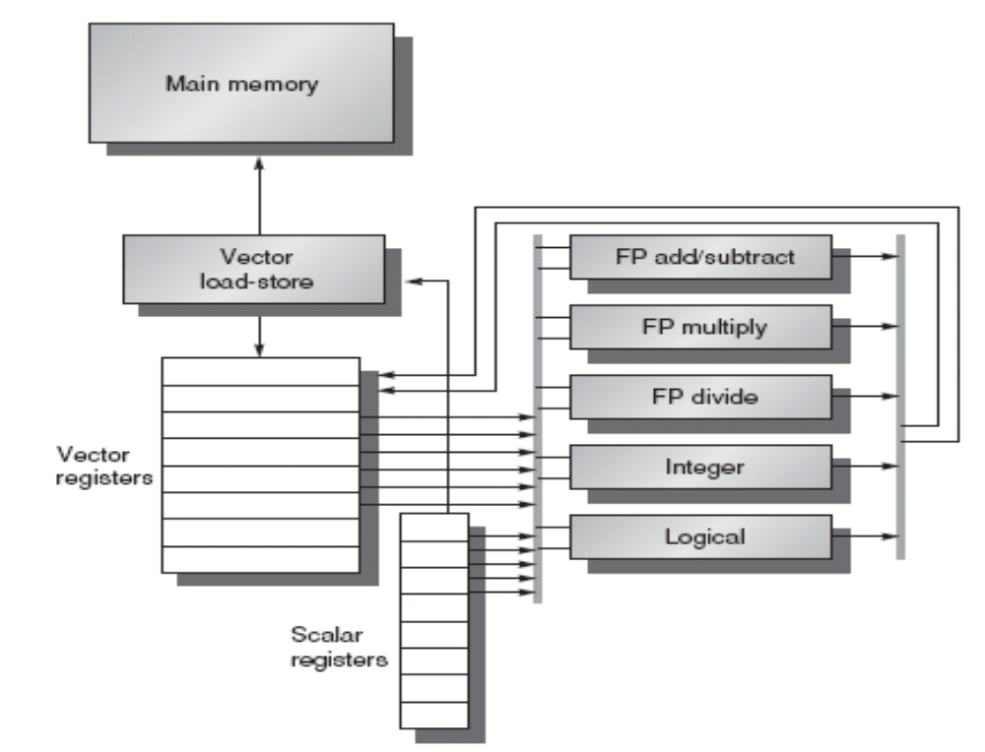
The basic structure of a vector-register architecture
VMIPS
Notes:
A vector processor typically consists of an ordinary pipelined scalar unit plus a vector unit.
This processor, which is loosely based on the Cray-1, is the foundation for discussion throughout most of this lesson.
We call it VMIPS; its scalar portion is MIPS, and its vector portion is the logical vector extension of MIPS.

Slide 11
Primary Components of VMIPS
Vector registers — VMIPS has eight vector registers, and each holds 64 elements. Each vector register must have at least two read ports and one write port.
Vector functional units — Each unit is fully pipelined and can start a new operation on every clock cycle.
Vector load-store unit —The VMIPS vector loads and stores are fully pipelined, so that words can be moved between the vector registers and memory with a bandwidth of 1 word per clock cycle, after an initial latency.
A set of scalar registers —Scalar registers can also provide data as input to the vector functional units, as well as compute addresses to pass to the vector load-store unit.

Slide 12
Vector Supercomputers
Epitomized by Cray-1, 1976:
Scalar Unit + Vector Extensions
Load/Store Architecture
Vector Registers
Vector Instructions
Hardwired Control
Highly Pipelined Functional Units
Interleaved Memory System
No Data Caches
No Virtual Memory

Slide 13
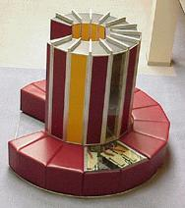
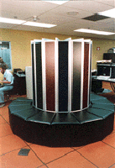
Cray-1 (1976)

Slide 14
Cray-1 (1976)
V0
V_{i}
V. Mask
V1
V_{j}
64 Element Vector Registers
V2
V. Length
V3
V_{k}
Single Port
Memory
16 banks of 64-bit words
+
8-bit SECDED
80MW/sec data load/store
320MW/sec instruction
buffer refill
V4
V5
V6
V7
FP Add
S0
S_{j}
FP Mul
( (A_{h}) + j k m )
S1
S2
S_{k}
FP Recip
64
T Regs
S_{i}
S3
(A₀)
S4
S_{i}
Int Add
T_{jk}
S5
S6
Int Logic
S7
Int Shift
( (A_{h}) + j k m )
A0
Pop Cnt
A1
A_{i}
A2
A_{j}
(A₀)
64
B Regs
A3
A_{k}
Addr Add
B_{jk}
A4
A5
A_{i}
Addr Mul
A6
A7
64-bitx16
NIP
CIP
4 Instruction Buffers
LIP
memory bank cycle 50 ns processor cycle 12.5 ns (80MHz)
Notes:
向量运算使用的功能部件有：整数加、逻辑运算、移位、浮点加、浮点乘、浮点迭代求倒数。
它们都是流水处理部件，且六个部件可并行工作。
单纠错、双错误检测代码（SECDED）逻辑

Slide 15
Vector Programming Model
Scalar Registers
Vector Registers
r7
v7
r0
v0
[0]
[1]
[2]
[VLRMAX-1]
Vector Length Register
VLR
v1
Vector Arithmetic Instructions
ADDV v3, v1, v2
v2
+
+
+
+
+
+
v3
[0]
[1]
[VLR-1]
Vector Load and Store Instructions
LV v1, r1, r2
Vector Register
v1
Memory
Base, r1
Stride, r2

Slide 16
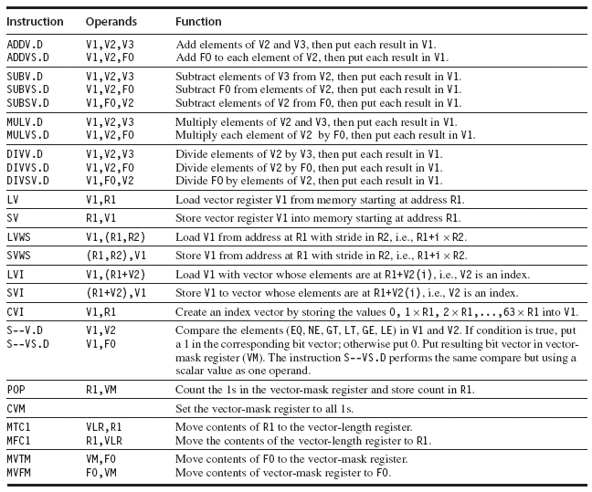
In VMIPS, vector operations use the same names as MIPS operations, but with the letter “V” appended.

Slide 17
Vector Code Example
# C code
for (i=0; i<64; i++)
C[i] = A[i] + B[i];
# Scalar Code
LI R4, 64
loop:
L.D F0, 0(R1)
L.D F2, 0(R2)
ADD.D F4, F2, F0
S.D F4, 0(R3)
DADDIU R1, 8
DADDIU R2, 8
DADDIU R3, 8
DSUBIU R4, 1
BNEZ R4, loop
# Vector Code
LI VLR, 64
LV V1, R1
LV V2, R2
ADDV.D V3, V1, V2
SV V3, R3

Slide 18
Vector Instruction Set Advantages
Compact
  one short instruction encodes N operations
Expressive, tells hardware that these N operations:
  are independent
  use the same functional unit
  access disjoint registers
  access registers in the same pattern as previous instructions
  access a contiguous block of memory (unit-stride load/store)
  access memory in a known pattern (strided load/store)
Scalable
  can run same object code on more parallel pipelines or lanes
Notes:
•一个短的指令包含多个操作
•是相互独立的
•使用相同的功能单元
•访问相互独立的寄存器
•和前一指令相同的方式访问寄存器
•访问一个连续的整块的内存单元（单元步幅的装入/存储）
•以一种已知的方式访问内存（一步加载/存储）
•可以在更多的流水线上运行相同的对象代码

Slide 19
3. How Vector Processors Work
3.1 An Example
Let’s take a typical vector problem, X and Y are vectors, a is a scalar.
Y = a×X + Y
This is the socalled SAXPY or DAXPY loop that forms the inner loop of the Linpack benchmark.
Example Show the code for MIPS and VMIPS for the DAXPY loop.
Assume that the starting addresses of X and Y are in Rx and Ry. And the number of elements, or length, of a vector register(64) matches the length of the vector operation.
Notes:
SAXPY stands for single-precision a⋅X plus Y; DAXPY for double-precision a ⋅ X plus Y.)
Linpack is a collection of linear algebra routines, and the routines for performing Gaussian elimination constitute what is known as the Linpack benchmark.

Slide 20
Here is the MIPS code.
L.D F0,a ;load scalar a
DADDIU R4,Rx,#512 ;last address to load
Loop: L.D F2,0(Rx) ;load X(i)
MUL.D F2,F2,F0 ;a × X(i)
L.D F4,0(Ry) ;load Y(i)
ADD.D F4,F4,F2 ;a × X(i) + Y(i)
S.D 0(Ry),F4 ;store into Y(i)
DADDIU Rx,Rx,#8 ;increment index to X
DADDIU Ry,Ry,#8 ;increment index to Y
DSUBU R20,R4,Rx ;compute bound
BNEZ R20,Loop ;check if done

Slide 21
Here is the VMIPS code for DAXPY.
L.D F0,a ;load scalar a
LV V1,Rx ;load vector X
MULVS.D V2,V1,F0 ;vector-scalar multiply
LV V3,Ry ;load vector Y
ADDV.D V4,V2,V3 ;add
SV Ry,V4 ;store the result
The most dramatic comparison is that the vector processor greatly reduces the dynamic instruction bandwidth.
Another important difference is the frequency of pipeline interlocks. (Pipeline stalls are required only once per vector operation, rather than once per vector element.)
Notes:
On the vector processor, each vector instruction will only stall for the first element in each vector, and then subsequent elements will flow smoothly down the pipeline.

Slide 22
Vector Arithmetic Execution
V1
V2
V3
Use deep pipeline (=> fast clock) to execute element operations
Simplifies control of deep pipeline because elements in vector are independent (=> no hazards!)
Six stage multiply pipeline
V3 <- v1 * v2
Notes:
The behavior of the load-store vector unit is significantly more complicated than that of the arithmetic functional units.

Slide 23
3.2 Vector Load-Store Units and Vector Memory Systems
Operation | Start-up penalty
Vector add | 6
Vector multiply | 7
Vector divide | 20
Vector load / store | 12
Start-up penalties (in clock cycles) on VMIPS
To maintain an initiation rate of 1 word fetched or stored per clock, the memory system must be capable of producing or accepting this much data. This is usually done by spreading accesses across multiple independent memory banks.

